Slide 1

ODIGEO Payments & Fraud – IT assessment
· TO BE Phase ·
Barcelona, February 2018

Slide 2
Index
00
00
01
02
03
03
04
05
06
07
Introduction
Definitions
Communica-tion
Entity Model
Annotations
DAO
JPA
Conclusions

Slide 3
00
Introduction

Slide 4
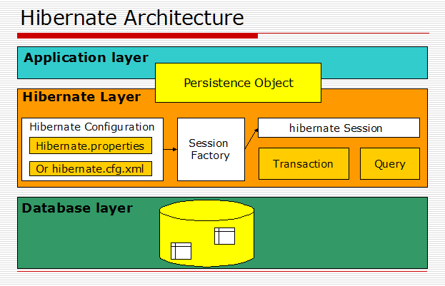


00
Introduction
What is Hibernate?
Hibernate is a free, open source object-relational mapping library for Java designed to map objects to an relational database management system (RDBMS) and to implement the object-oriented programming concepts in a relational database.
Why use hibernate?
Hibernate is a framework which provides some abstraction layer means programmer don’t have to worry about the implementations, Hibernate do implementations for you internally like Establishing a connection with the database, writing query to perform CRUD operations etc.

Slide 5
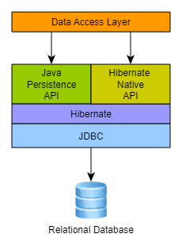
00
Introduction
What is JPA?
The Java Persistence API (JPA) is a specification of Java. It is used to persist data between Java object and relational database. JPA acts as a bridge between object-oriented domain models and relational database systems.
Why use JPA?
Spring Data JPA aims to significantly improve the implementation of data access layers by reducing the effort to the amount that’s actually needed. As a developer you write your repository interfaces, including custom finder methods, and Spring will provide the implementation automatically

Slide 6
01
Definitions

Slide 7
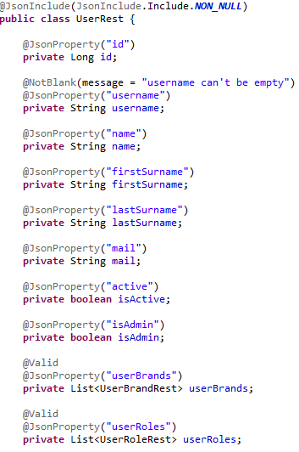
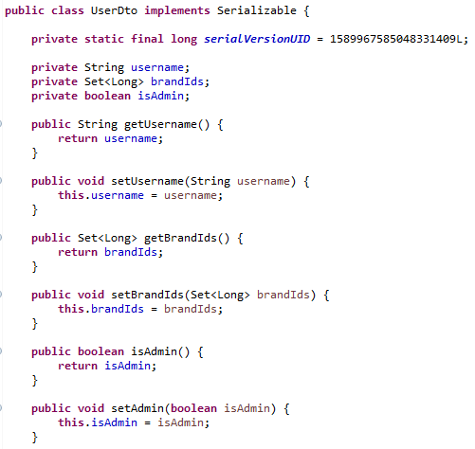
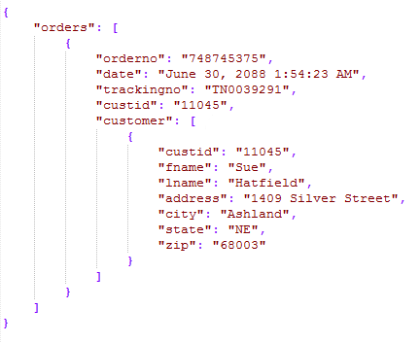
01
Definitions
JSON
JavaScript Object Notation is a lightweight data-interchange format. It is easy for humans to read and write.
DTO
A data transfer object is an object that carries data between processes

Slide 8
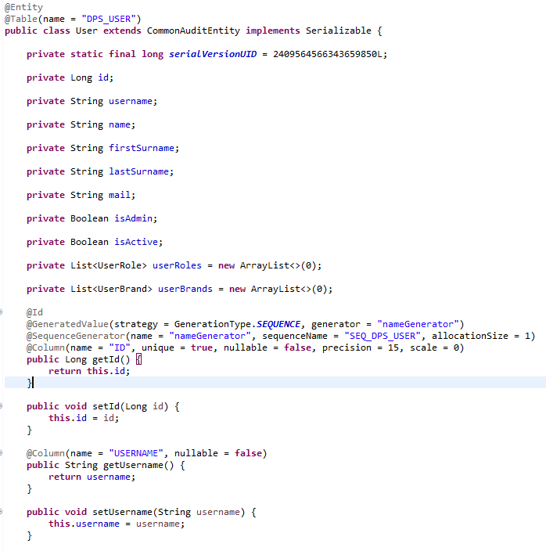
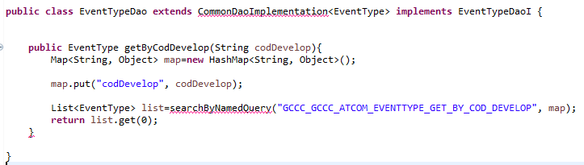
01
Definitions
DAO
Data Access Object is in charge of abstract and encapsulate all access to the data source. The DAO manages the connection with the data source to obtain and store data.
Entity
An entity is a lightweight persistence domain object. Typically, an entity represents a table in a relational database.

Slide 9
02
Communication

Slide 10
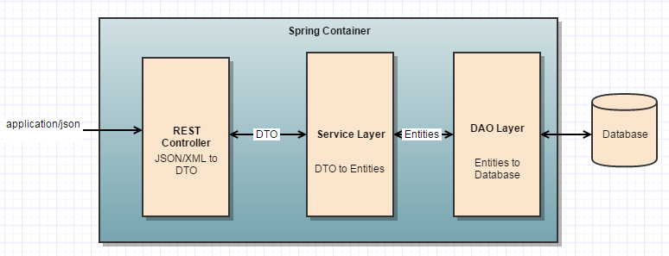


02
Communication
Layers
Benefits
Code can be re-used by multiple clients.
Third parties have an integration point into our system.
Duplicated business logic is centralized.
Easy way to refactor.
Easy way to chnge the business logic.
Database model can be updated easier.
JPA
or
How is the communication between services?
DTOs beacuse if we work with shared entities between services we could get transaction problems i.e. detached entities, blocking entities for another user, entities with not updated/real data, etc..

Slide 11
03
Entity Model

Slide 12
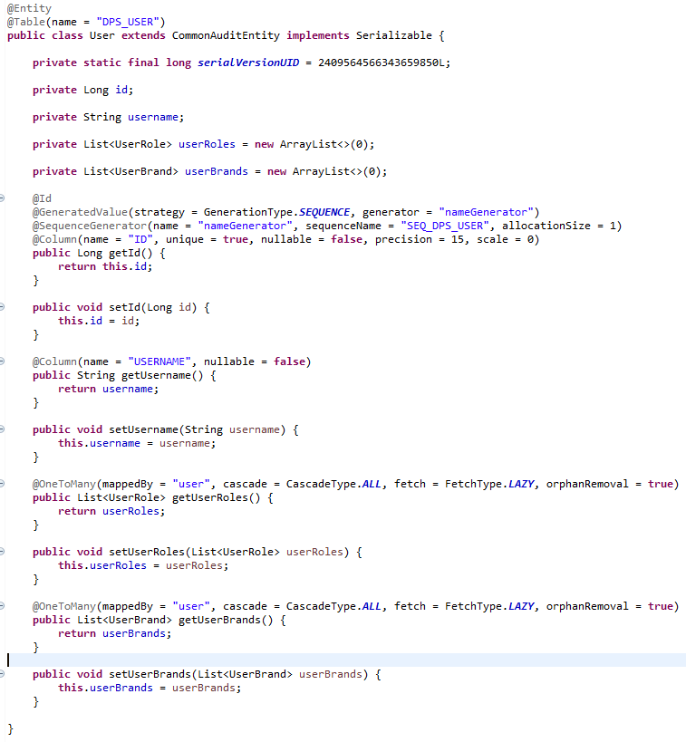
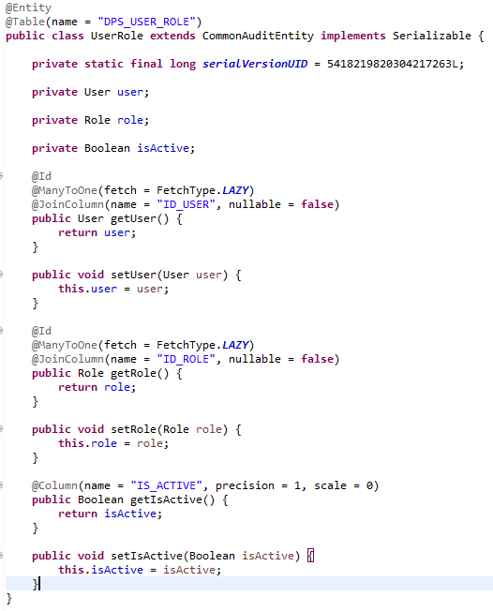
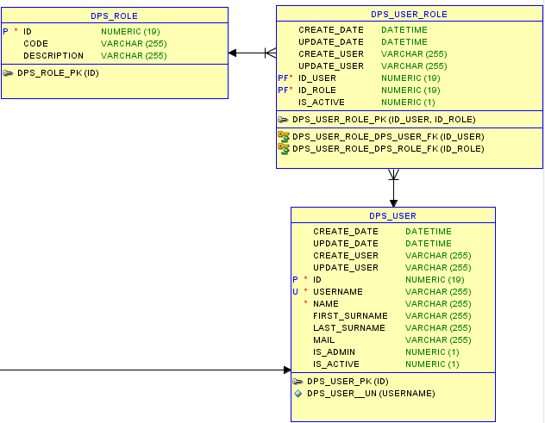

03
Entity Model
Many to Many problem divided in two One to Many.
Composite Primary Key for the new table.

Slide 13
04
Annotations

Slide 14
04
Annotations
Entity: Annotate all your entity beans with @Entity.
Table: Specify the database table this Entity maps
Column: Specify the column mapping using
Id: The id Column
Generated Value: Let database generate the id column.
Strategy: How is the Id generated (Auto, sequence, table, identity)
SequenceGenerator: The sequence name in database if we use sequence strategy.
OneToMany: Inditifies the relationship between tables
mappedBy: Signals hibernate that the key for the relationship is on the other side. MappedBy allows you to still link from the table not containing the constraint to the other table. In this case User is in the UserBrand table.
Cascade: This delete/merge/detach the child entity when its parent is modified.
orphanRemoval: It marks "child" entity to be removed when it's no longer referenced from the "parent" entity.
Fetch: Data Loading Type. Recommended Lazy (data is loaded only if it’s necessary.)

Slide 15
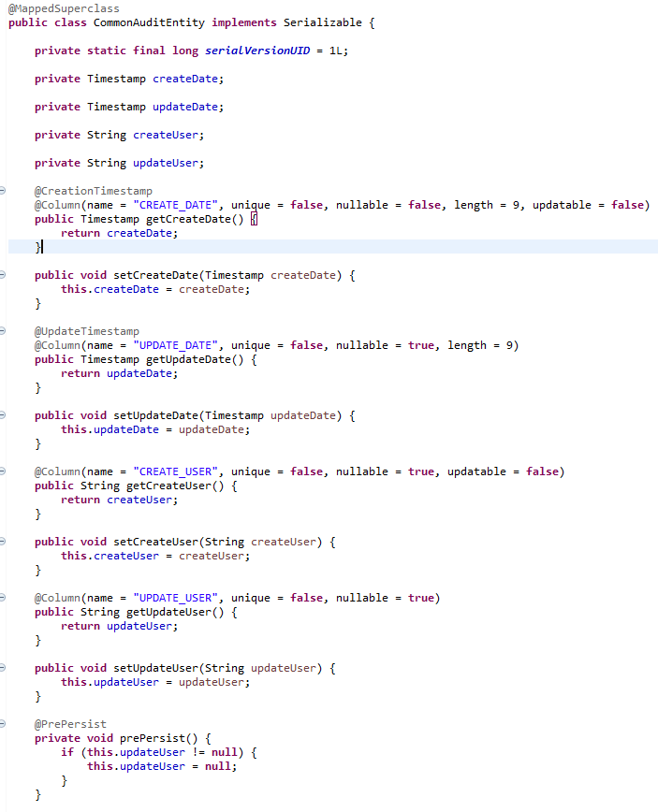
04
Annotations
MappedSuperClass: This class can be mapped in the same way as an entity except that the mappings will apply only to its subclasses since no table exists for the mapped superclass itself.
CreationTimeStamp: Set the Date to the column when a new entity is persisted.
UpdateTimeStamp: Set the Date to the column when a new entity is updated.
Updatable: If we want a column to never update.
Nullable: To check nullable column (should be controlled in data base.)
PrePersist: Actions to do before a new entity is persisted.
PreUpdate: Actions to do before a new entity is updated.

Slide 16
05
DAO

Slide 17
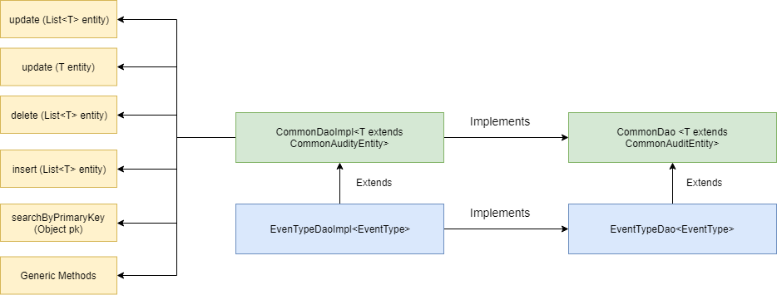

05
DAO
Best solution if you need to use the same methods for all your entites.
All common methods for any DAO are declared in CommonDao Interface and Implemented in CommonDaoImpl.
CommonDao and Impl use type T so any entity can be used.
It’s possible to extend from CommonAudityEntity in case all entities are been audited.
EvenTypeDao extends from CommonDao Interface so it’s not necessary to declare all methods again.
EventTypeDaoImpl extends from CommonDaoImpl so it’s possible to use all methods from CommonDaoImpl.

Slide 18
06
JPA

Slide 19
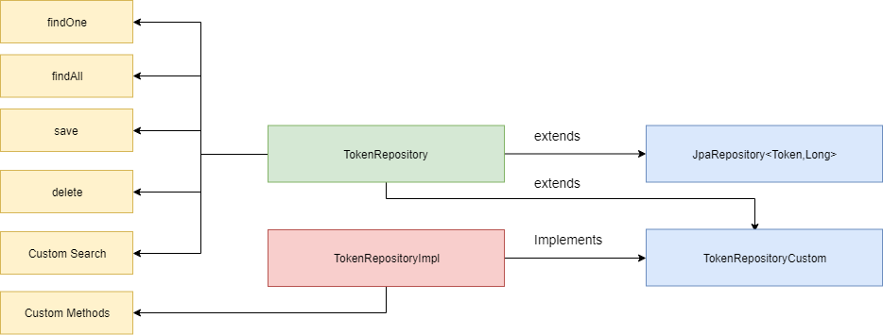
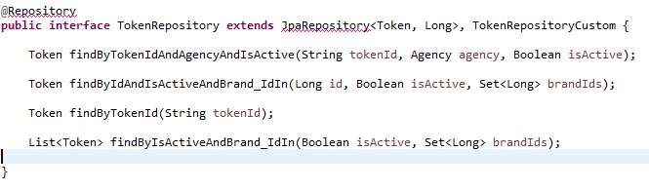
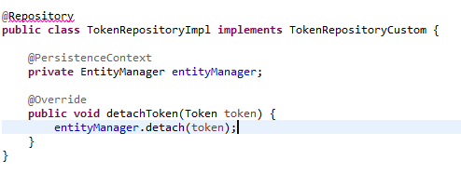
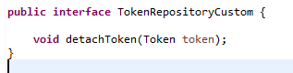
06
JPA
JPA allows you to avoid writing DDL(data definition language) in a database specific dialect of SQL. Instead you write "mappings" in XML, or using Java annotations.
JPA allows you to avoid writing DML(data management language) in the database specific dialect of SQL.
JPA allows you to load and save Java objects and graphs without any DML language at all.
When you do need to perform queries JPQL allows you to express the queries in terms of the Java entities rather than the (native) SQL tables and columns...

Slide 20
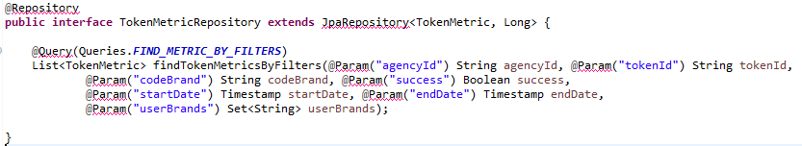
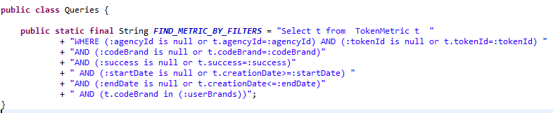
06
JPA
Spring Data JPA: Custom queries And find By Attributes.
findBy+Entity Attribute → findByName.
findBy+And → findByNameAndEmail.
findBy+Attribute inside child entity → findByNameAndAddress_ZipCode.
find+Order → findByNameAndOrderByCreationDateAsc
find+ Limit results → findFirst10ByName
findAll
find + List Attributes→ finByNameIn
Sorting
Pagination
Future
Stream
……….

Slide 21
07
Conclusions

Slide 22
07
Conclusions
JPA + Hibernate Benefits.
Developer productivity: You have to define the mapping between the database tables and your domain model only once to use it for all write and most of your read operations. On top of that, you get a lot of additional features that you otherwise would need to implement yourself, like primary key generation, concurrency management, and different performance optimizations.
Database Independent: If you try to use the same code with different databases, you quickly run into issues caused by different SQL dialects. SQL is the standard language to interact with a database, but each database uses a slightly different dialect. Forget about it with JPA and HIbernate, just switch your connector in your pom.
Type and Parameter Handling: You don’t have to define any SQL data types, when you define your entity mapping. Your JPA implementation hides these transformations from your code and uses a default mapping.
Avoid Unnecessary Queries: The write-behind optimization is one of several performance optimizations you get with JPA. The basic idea is to delay all write operations as long as possible so that multiple update statements can be combined into one. Your JPA implementation, therefore, stores all entities that were used within one transaction in the first level cache.
Caching: Is another performance tuning feature that you get almost for free if you use JPA. The first-level cache, which contains all entities used within a transaction.

